Slide 1
To look forward to
Part 9: Rev 22
Fixing our sight on God’s revelation of the future
Preached by Dr. Jim Harmeling at Crossroads International Church Singapore • CICFamily.com Uploaded by Dr. Rick Griffith • Singapore Bible College Files in many languages for free download at BibleStudyDownloads.org

Slide 2
To look forward to
Fixing our sight on God’s revelation of the future

Slide 3
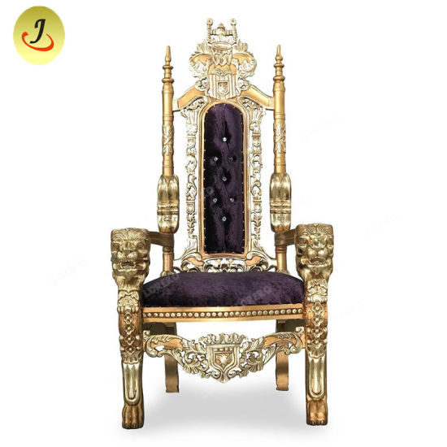
Christ
Returns
with Church
Final
Battle
Human
opponents
destroyed
Satan
released
Satan
bound
1000 years

Slide 4
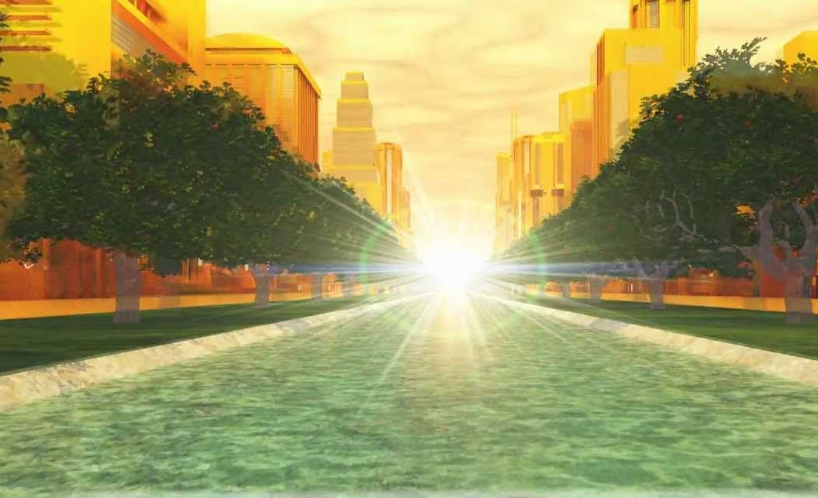
Great White Throne Judgment
New World, New Jerusalem

Slide 5
R E V E L A T I O N 2 2
THINK: Hope in the New World (vs 1-5)

Slide 6
Genesis 2:8-10
⁸ And the Lord God planted a garden in Eden, in the east, and there he put the man whom he had formed. ⁹ And out of the ground the Lord God made to spring up every tree that is pleasant to the sight and good for food. The tree of life was in the midst of the garden, and the tree of the knowledge of good and evil.
¹⁰ A river flowed out of Eden to water the garden, and there it divided and became four rivers.

Slide 7
R E V E L A T I O N 2 2
THINK: Hope in the New World (vs 1-5)
DO: Keep the Charge (vs 6-16, 18-19)

Slide 8
Keep these words and be prepared (6-7)
Retain focus on God (8-9)
Proclaim prophetic words urgently (10-16)
Proclaim prophetic words truthfully (18-19)

Slide 9
R E V E L A T I O N 2 2
THINK: Hope in the New World (vs 1-5)
DO: Keep the Charge (vs 6-16, 18-19)
PRAY: Call for Jesus to Come Back Now (vs. 17, 20-21)

Slide 10
Black

Slide 11
Topical Preaching link at BibleStudyDownloads.org
Get this presentation for free!
Notes:
The Bible…Basically (bb)

